Slide 1
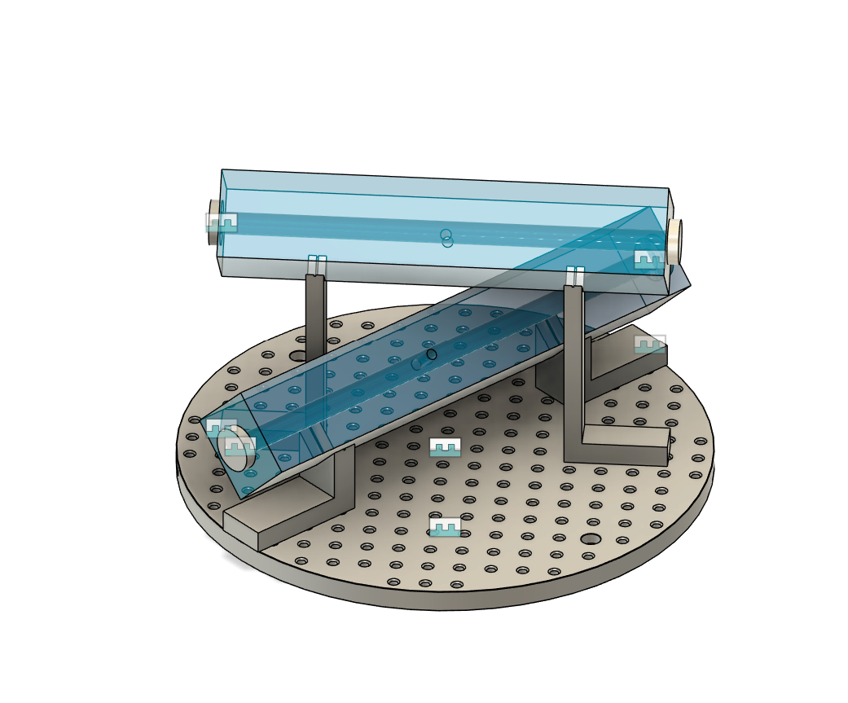
Cavities
The spacers and the mirrors can be manufactured and assembled by Layertec.
Delivery 5 months from PO
30 and 25 cm
Mounting is TBD

Slide 2
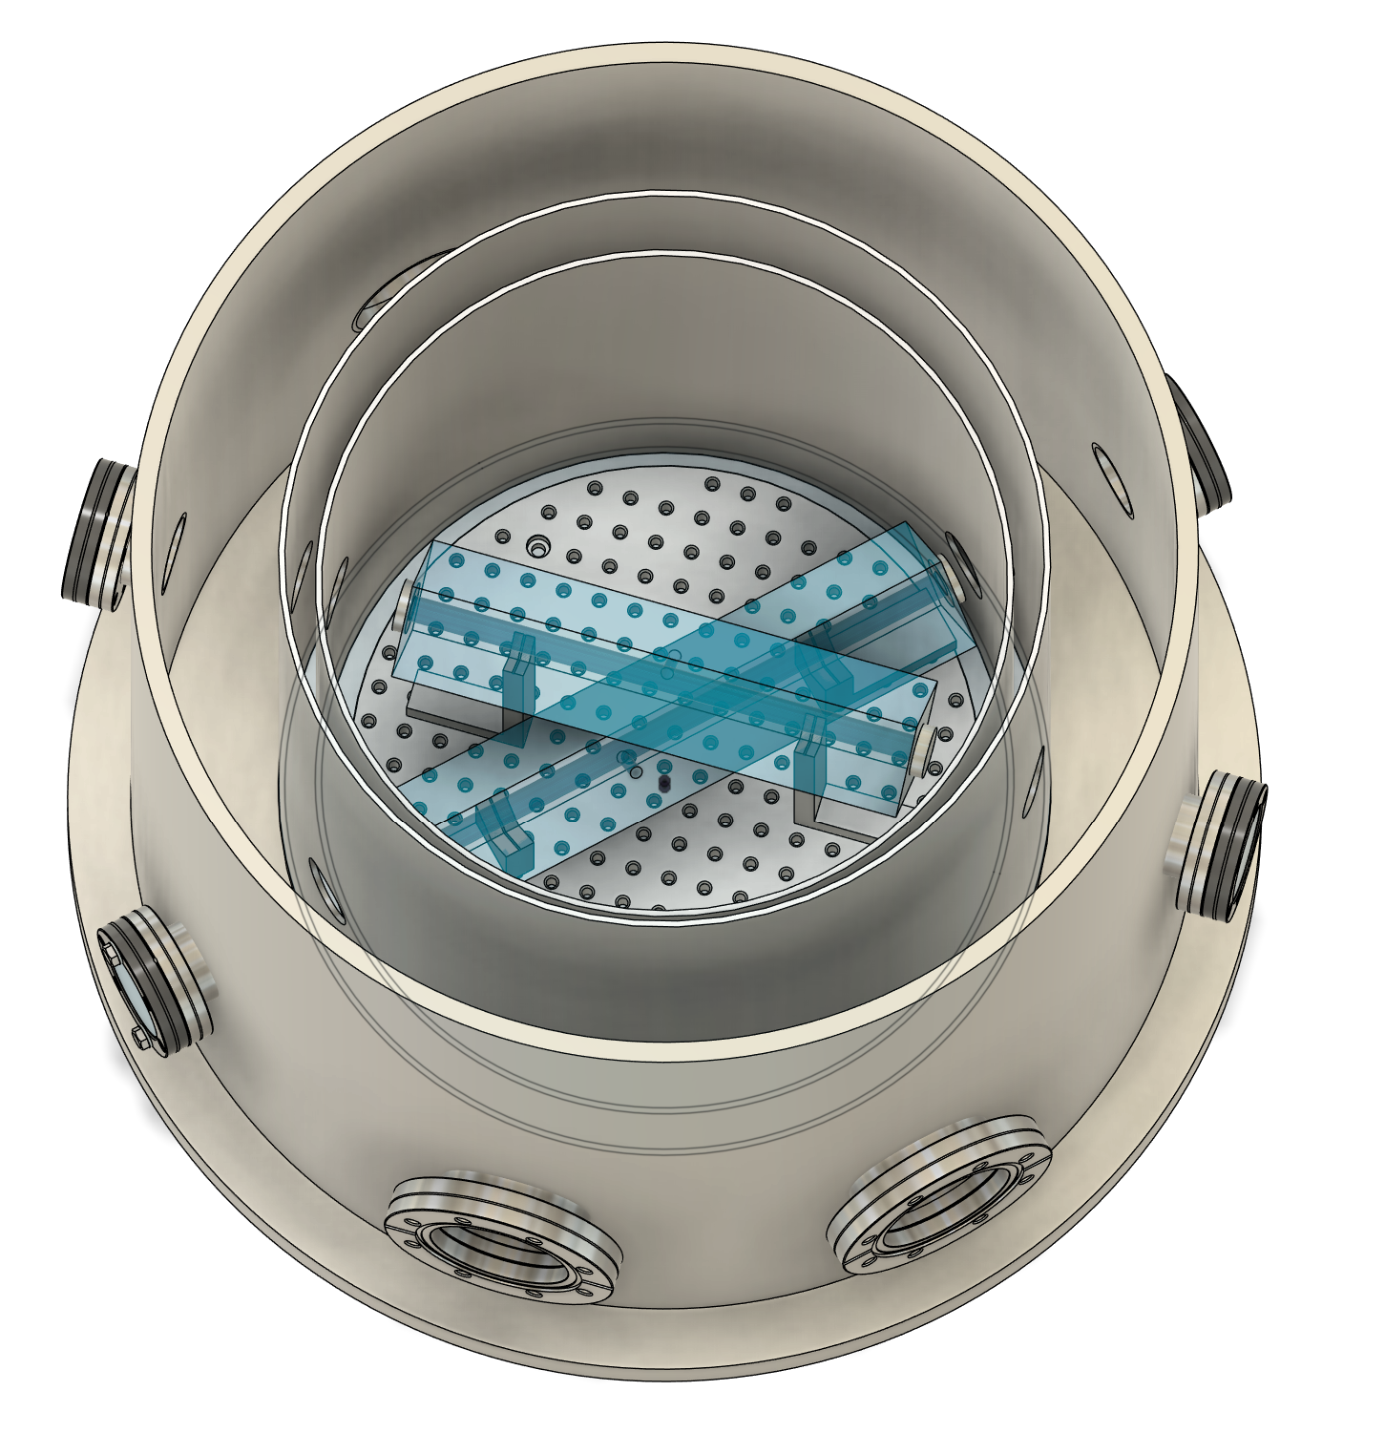
Vacuum and Thermal
Will talk to Philip Möhle about the desing
3 layers of aluminum shielding looks good
4 viewports, 4 additional flanges (?)
Couple of ideas for mounting
Glass spheres between the layers
or spacer, maybe made from PEEK
Lesker can do it, but I’m also waiting for a response from Allectra and Pfeiffer
The pumps?

Slide 3
Conference
Went well
I won’t write the proceedings

Slide 4
Short term plan
Critical things to order:
Lasers – Depends on how the currently lasers can perform
Table – Could be ordered, maybe at the same time as the lasers?
Vacuum – I’m gathering quotes, have a rough design
Cavities – I need to clarify the available RoCs, but hope to get the PO out in the coming weeks (by the end of August)
Interlock?
Write the first article comparing the testbed to LISA – A rough draft also by the end of August?

Slide 5
Short term plan
Critical things to order:
Lasers – Depends on how the currently lasers can perform
Table – Could be ordered, maybe at the same time as the lasers?
Vacuum – I’m gathering quotes, have a rough design
Cavities – I need to clarify the available RoCs, but hope to get the PO out in the coming weeks (by the end of August)
Interlock?
Write the first article comparing the testbed to LISA – A rough draft also by the end of August?

Slide 6
Short term plan
Critical things to order:
Lasers – Depends on how the currently lasers can perform
Table – Could be ordered, maybe at the same time as the lasers?
Vacuum – I’m gathering quotes, have a rough design
Cavities – I need to clarify the available RoCs, but hope to get the PO out in the coming weeks (by the end of August)
Interlock?
Write the first article comparing the testbed to LISA – A rough draft also by the end of August?

Slide 7
Short term plan
Critical things to order:
Lasers – Depends on how the currently lasers can perform
Table – Could be ordered, maybe at the same time as the lasers?
Vacuum – I’m gathering quotes, have a rough design
Cavities – I need to clarify the available RoCs, but hope to get the PO out in the coming weeks (by the end of August)
Interlock?
Write the first article comparing the testbed to LISA – A rough draft also by the end of August?

Slide 8
Short term plan
Critical things to order:
Lasers – Depends on how the currently lasers can perform
Table – Could be ordered, maybe at the same time as the lasers?
Vacuum – I’m gathering quotes, have a rough design
Cavities – I need to clarify the available RoCs, but hope to get the PO out in the coming weeks (by the end of August)
Interlock?
Write the first article comparing the testbed to LISA – A rough draft also by the end of August?

Slide 9
Short term plan
Critical things to order:
Lasers – Depends on how the currently lasers can perform
Table – Could be ordered, maybe at the same time as the lasers?
Vacuum – I’m gathering quotes, have a rough design
Cavities – I need to clarify the available RoCs, but hope to get the PO out in the coming weeks (by the end of August)
Interlock?
Write the first article comparing the testbed to LISA – A rough draft also by the end of August?

Slide 10
Issues
Lasers and table
And the lab infrastructure
I need a TAC committee

